Slide 1
GCAM Assignment #4
ITM 20235575 Jiseok AHN

Slide 2
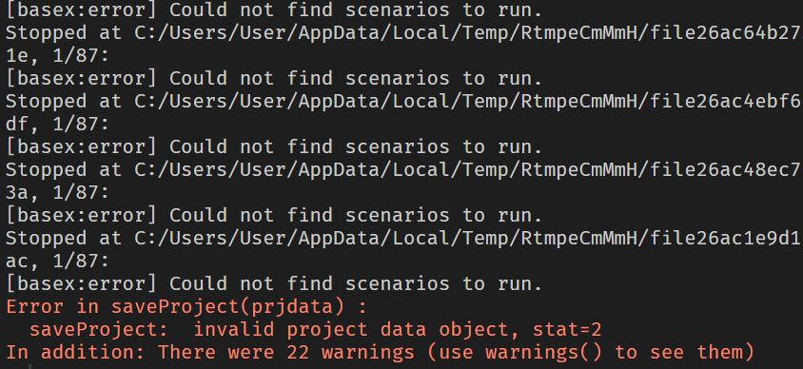
Model assumption
I ran two different scenarios(with tax, without tax) using the given material for GCAM assignment 2(carbon_tax_25_5_mod.xml file)
When trying to import the DB data into R using gcamextractor, error occurs.
The plots from this assignment are done with the combination of model interface, excel, and R ggplot2.

Slide 3
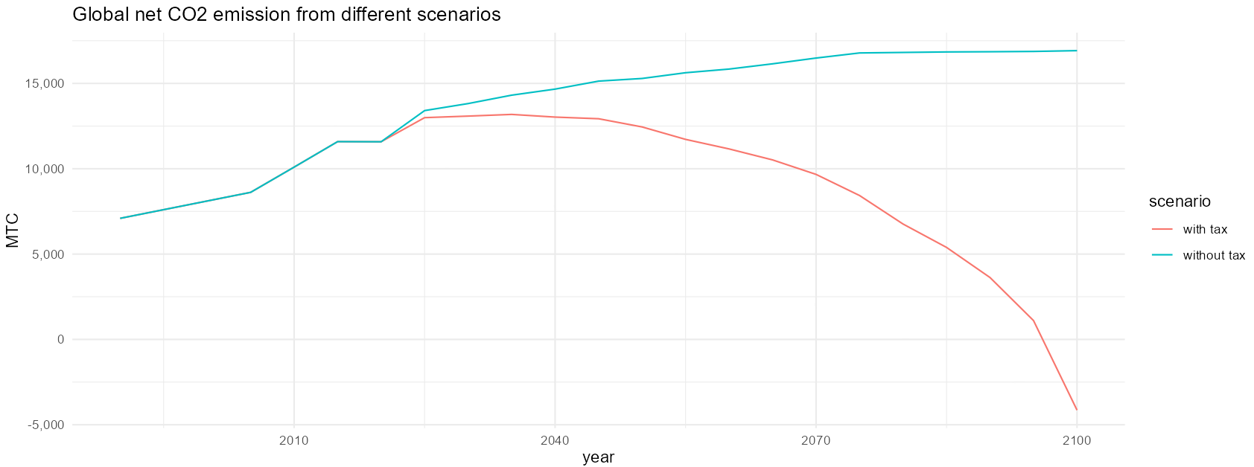
Gloally, how much energy carbon emissions reductions achieved under each policy design? How much LUC emissions reductions achieved?
- With land taxation, global net CO2 emission goes to zero in 2010.

Slide 4
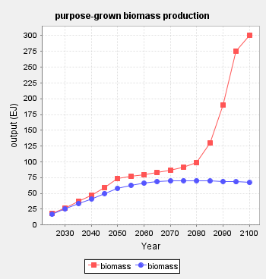
Globally, how will bioenergy consumption change between the two policy designs? And how will cropland and forest cover change?
- When implementing land carbon tax, purpose-grown biomass production dramatically increases.
With tax
Without tax

Slide 5
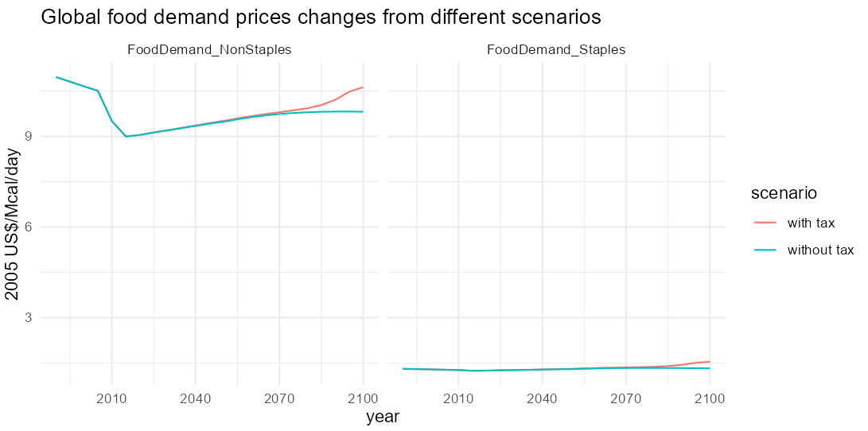
Globally, how will food prices and food consumption change between the two policy designs?
- Food demands are categorized as two, NonStaple and Staples.

